Slide 1
Thinking About Root Cause
Terry Long
Nancy O’Hara

Slide 2

Why root cause?
In education, we often identify the problem (symptom) and jump to the solution
Then we wonder why the solution failed!
This Photo by Unknown Author is licensed under CC BY-SA

Slide 3

Root cause analysis…
Means spending time to identify the causes of the problem
  Often multiple causes
  Requires digging deep to get to the root(s)
Can eliminate wasted effort on initiatives that will not solve the actual source of the problem
Encourages reflection on current practices
Provides rationale for strategy selection

Slide 4
When is a cause the ROOT cause?
Single specific root causes are rare in education
Instead, think about clusters of factors
Ask the team these questions:
  Would the problem have occurred if the cause had not been present?
  Will the problem reoccur as the result of the same cause if the cause is corrected or dissolved?
  Will correction or dissolution of the cause lead to similar events?

Slide 5

Would the problem have occurred if the cause had not been present?
No, then it is a root cause
Yes, then a contributor but not a root cause
Will the problem reoccur as the result of the same cause if the cause is corrected or dissolved?
No, then it is a root cause
Will correction or dissolution of the cause lead to similar events?
No, then it is a root cause
Yes, then a contributor but not a root cause
Yes, then a contributor but not a root cause
Have you dug deep enough?

Slide 6
Others signs you have dug deep enough:
You run into a dead end asking what caused the proposed root cause.
The team agrees that is the root cause.
The cause is logical, makes sense, and provides clarity to the problem.
The cause is something you can influence and control.
If the cause is dissolved, there is realistic hope that the problem can be reduced or prevented in the future.

Slide 8
Getting to the Root Cause
There are multiple ways to identify and address root cause
Success Gaps toolkit is designed to identify root causes of success gaps in education
BUT, the facilitator must guide the team to keep digging until you get to root cause
  Don’t address the symptom, dig until you identify root cause

Slide 9

The 5 Whys
Success Gaps rubric is set up to use the five Whys as part of the guiding questions and evidence documentation
This is a technique that involves identifying a problem and asking why five times….think young children
WHY?
Why?
WHY?
Why?
WHY???

Slide 10
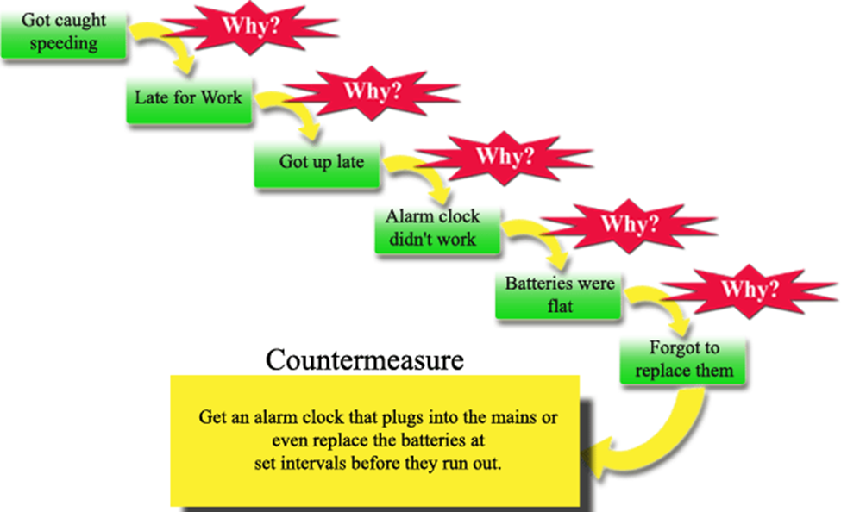
Notes:
http://www.educational-business-articles.com/5-whys.html

Slide 11
Problem Statement
WHY?
symptom
WHY?
symptom
WHY?
symptom
WHY?
symptom
WHY?
Root Cause

Slide 12
Parents don’t feel they receive timely communication
Problem
WHY?
Parents don’t check school website
WHY?
They might not know the information is there
WHY?
We haven’t told parents the information is there
WHY?
Haven't made time to meet with parents or prepare materials to share
WHY?
It is not something we usually plan for

Slide 13
Black SWD are OSS 4 X rate of black students in general ed
WHY?
Most common infraction is disrespect
WHY?
The students don't really care if they get in trouble
WHY?
They want out of class
WHY?
They are behind in the work
WHY?
They have not had instruction that meets their needs
Notes:
Black SWD are suspended out of school at a rate that is more than four percentage points greater than Black students in general education in the same district. For the district to be identified with sig dispro, this four percentage point difference has to have occurred for three or more consecutive school years.

Slide 14
Data mining – observations/reactions
Start with your profile and react to it
  What are the red areas?
  What are your initial thoughts or reactions?
  What do you know about the data?
  Is it a change or a trend?
  Does the data surprise you?
  What do you want to know?

Slide 15
Data mining - interpretations
Interpreting the data?
  What does the data tell you?
  What thoughts or assumptions do these data confirm?
  What are the limitations to your conclusions?
  What are your next questions?
  What further data do you want to see?

Slide 16
Data mining - Implications
What are the implications?
Why does this matter?
What is/are the root cause(s), do we know yet?
What do we still need to find out? Do we have enough data/information to move forward?

Slide 17

Addressing Success Gaps in Arkansas
Thinking about Equity, Inclusion and Opportunity
Nancy O’Hara
Terry Long

Slide 18

Meeting Norms
This is a judgment free zone!
All opinions and thoughts are of value.
Everyone is involved in the discussions.
Vegas rules apply!

Slide 19
Team Work
What is the story of disproportionality in your district?
  What was your area of disproportionality?
  What does your data tell you? What were your root causes?
  What was your plan for last year? How did it go?
Prepare three to five bullets to tell your story to the other teams
  Consider the “good, the bad and the ugly”!
Notes:
Give them about 15-20 minutes to talk and create a chart, then debrief as a group

Slide 20
Why Equity, Inclusion and Opportunity: Addressing Success Gaps?
Disproportionality (broad term to include discrepancy, significant disproportionality and disproportionate representation) is more than a special education issue.
Resolving or improving disproportionality requires whole school/district approaches, and is not limited to special education.
Disproportionality for discipline or identification is often the first of disparate outcomes for youth with disabilities throughout their lives.
Notes:
For this presentation, when disproportionality is written in italics, it is referring to the broad inclusive category of significant discrepancy, disproportionate representation and significant disproportionality.

Slide 21
Is educational equity really an issue?
Nationally
Black children represent 18% of preschool enrollment, but 48% of preschool children who receive more than one out of school suspension
Annually about 5% of white students are suspended or expelled and 16% of black students
Black students are 2.5 times more likely to be identified as a student with intellectual disability as any other student group

Slide 22
Discipline
Nationally, Black or African American students with disabilities are…
3.8 times as likely to receive out-of-school suspensions for more than 10 days as all other students
SOURCE: 2014-2015 OSEP Discipline and Child Count and Educational Environment Part B State Level Data Files
Notes:
https://www2.ed.gov/programs/osepidea/618-data/state-level-data-files/index.html#bd

Slide 24
2013-14 CRDC: Preschool Discipline
Black preschool children are 3.6 times as likely to receive one or more out-of-school suspensions as white preschool children.
  Black children represent 19% of preschool enrollment, but 47% of preschool children receiving one or more out-of-school suspensions;
  in comparison, white children represent 41% of preschool enrollment, but 28% of preschool children receiving one or more out-of-school suspensions.
  Children with disabilities served by the Individuals with Disabilities Education Act (IDEA) represent 20% of preschool enrollment, but 15% of preschool children receiving one or more out-of-school suspensions.

Slide 25
Arkansas – IDEA Discipline Data 2015-2016
Disability Category | Count of SWD with One or More Disciplinary Removals | Count of Students with Disabilities (IDEA Child Count "snapshot") | Percent of SWD with One or More Disciplinary Removals
All Disabilities | 11695 | 68178 | 17%
Emotional disturbance | 424 | 841 | 50%
Other health impairment | 3377 | 11033 | 31%
Specific learning disability | 4768 | 18528 | 26%
Intellectual disability | 1221 | 6131 | 20%
Traumatic brain injury | 24 | 150 | 16%
Hearing impairment | 51 | 462 | 11%
Autism | 468 | 4372 | 11%
Visual impairment | 19 | 238 | 8%
Speech or language impairment | 1233 | 16900 | 7%
Orthopedic impairment | 14 | 209 | 7%
Multiple disabilities | 89 | 1459 | 6%
Deaf-blindness | 0 | 4 | 0%
Developmental delay | 7 | 7851 | 0%

Slide 27
Do Black Students Misbehave More?
.
Of 32 infractions, only 8 significant differences
White students referred more for:
Smoking
Vandalism
Leaving w/o permission
Obscene Language
Black students referred more for:
Disrespect
Excessive Noise
Threat
Loitering
Notes:
Skiba, R.J., Michael, R.S., Nardo, A.C. & Peterson, R. (2002). The color of discipline: Sources of racial and gender disproportionality in school p
Skiba, R.J., Michael, R.S., Nardo, A.C. & Peterson, R. (2002). The color of discipline: Sources of racial and gender disproportionality in school punishment. Urban Review, 34, 317-342.

Slide 28
What is a success gap?
Differences or “gaps” in a variety of educational factors and outcomes that affect the likelihood of educational success for some groups of students compared to their peers
Achievement
Identification and/or placement for special education
Suspension rates
College and career preparation
Graduation rates
Notes:
We will show you some sample data exemplifying these success gaps.

Slide 29


What are the results of success gaps?
Poor long-term outcomes for entire groups of students
Notes:
Before clicking on the answer to make it appear, ask the participants to share thoughts….pick only a couple of participants

Slide 30

To address success gaps…
… look closely at equity, inclusion, and opportunity for students who are not being successful!

Slide 31
How to Address Success Gaps
Form a team
Study the data
Conduct a self-assessment
Provide evidence
Consider the students first
Ensure equitable participation
Develop a plan of action

Slide 32
Who should be on our district team?
Curriculum specialist
General education and special education teachers
Building principals
Special education director
Parents of students in focus subgroup
Community members with an interest
Other district and school representatives with an interest in the focus

Slide 33


Notes:
We developed a tool to help states, districts, and schools look at the services and supports they were providing for all students, help them to identify areas where there were gaps (achievement gaps, opportunity gaps, gaps in other areas) for other subgroups of students compared to everyone else or each other. It’s to use to assess the degree to which their systems are being responsive to the diverse needs of all of their students.
Purpose of the Success Gaps documents: The “Success Gaps” documents are designed for schools and districts to use to assess the degree to which their systems are being responsive to the diverse needs of all of their students.
The “Success Gaps” documents are also designed to help districts/schools identify and then plan to address some of the systemic, contributing factors that result in over-representation of minority students in special education.

Slide 34
Arkansas School District Data Resources
Demographic Profiles - SPECIAL EDUCATION DISTRICT PROFILE 2014/15
https://arksped.k12.ar.us/documents/data_n_research/PublicReporting/LEAprofiles/SAProfiles1415.pdf
Coordinated Early Intervening Services (CEIS) Profiles
https://arksped.k12.ar.us/documents/data_n_research/PublicReporting/201415CEISMerged.pdf

Slide 35
Investigate the root causes of your success gaps
Have you implemented these five elements of high quality education?
Data-based decision making
Cultural responsiveness
High-quality core instructional program
Universal screening and progress monitoring
Evidence-based interventions and supports
Notes:
Research shows that paying attention to these five factors can assist districts and schools to achieve more equitable success among all subgroups. Each of these sections are supported by research in the white paper. Many of the documents/articles cited are great resources for more detailed information.

Slide 36

Data-Based Decision Making
Use disaggregated data for decisions about
  Curriculum and instructional programs
  Academic and behavioral supports
  Are policies and procedures effective?
Make decisions about student interventions using multiple data sources, including
  Screening
  Progress monitoring
  Formative and summative evaluation data

Slide 37

Cultural Responsiveness
Recognize diversity across student ethnicity, language, and socio-economic status
Provide training and resources so teachers can meet the linguistic needs of all students
Include parents from all backgrounds in discussions about the school and about their children’s progress
Notes:
Note about parents included in each section!

Slide 38

Core Instructional Program
Rigorous, consistent, and well-articulated K-12 instructional program, aligned with standards, delivered with fidelity
Effective differentiation in the core curriculum
Universal design for learning
Informing parents in their native or home language about differentiation

Slide 39

Assessment
Valid universal screening
Progress monitoring for all students
Informing parents in their native or home language about results

Slide 40

Evidence-Based Interventions and Supports
Implemented with fidelity
Instructional
Behavioral
  such as Positive Behavioral Supports or Restorative Justice
  Tiered response protocols, not zero tolerance
Informing parents in their native or home language about interventions and responses
Notes:
What are we missing? Are there other areas you would include?
What do you think? In your school or district, there is room for improvement in:
Data based decision making
Cultural responsiveness
Core instructional program
Assessment
Evidence based interventions and support

Slide 41
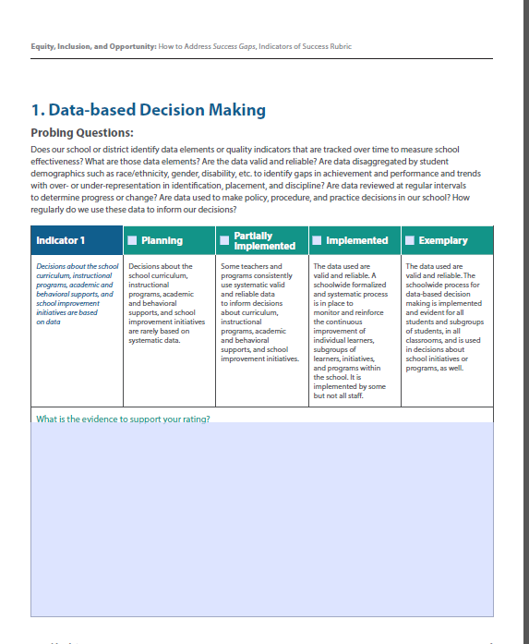
Rubric Organization
Content Area
Rubric rating scale
Probing Questions
Indicator
Text box to describe evidence to support rating of the team
Notes:
Lets start with the set up of the rubric. Each section or content area is set this way. Many of the content areas have more than one indicator and therefore are on multiple pages.
The scale is is the same across each area, Planning, Partially Implemented, Implemented, Exemplary, although described below the scale in the description of the indicator.

Slide 42
Data-based Decision Making
Indicator: Decisions about the school curriculum, instructional programs, academic and behavioral supports, and school improvement initiatives are based on data
Read the probing questions and the scale.
What data, based on your SD issue, would you disaggregate and pay particular attention to?
Thinking about your self-assessment and your plan, are there still some gaps?
How would you rate your district/schools?
Do you need to amend your plan?

Slide 43
Team Discussion
In your team, review the assigned section and discussion among yourselves.
  How would you rate your district for this section now
  Use your data, your self-assessments and your CEIS plan as resources.
  Determine if there is more data you want to review
  Determine if there are gaps in your current reviews (such as the self-assessment, etc)
  Identify some next steps for enhancing this section
Prepare a summary of your discussion and plan to share with the group

Slide 44
Cultural Responsiveness
Indicators: Culturally responsive instructional interventions and teaching strategies; Preparation for linguistic diversity; Facilitating the participation of parents
Questions: Review the probing questions and consider your responses

Slide 45
Team Discussion
In your team, review the assigned section and discuss among yourselves.
  How would you rate your district for this section now
  Use your data, your self-assessments and your CEIS plan as resources.
  Determine if there is more data you want to review
  Determine if there are gaps in your current reviews (such as the self-assessment, etc)
  Identify some next steps for enhancing this section
Prepare a summary of your discussion and plan to share with the group

Slide 46
End of day 1

Slide 47
Other sections of the rubric
Core Instructional Program
  Consistent, well-articulated curriculum implemented with fidelity
  Scientifically-based instructional program
  Differentiated instruction
  Informing parents and guardians about the core instructional program

Slide 48
Other sections of the rubric
Assessment-universal screening and progress monitoring
  Universal screening
  Progress monitoring
  Informing parents and guardians about screening and progress monitoring results

Slide 49
Other sections of the rubric
Interventions and Supports
  Evidence-based behavioral interventions and supports, in addition to core instruction, are embedded within a multi-tiered framework and implemented with fidelity
  School-level practices use tiered response methods (MTSS) that include academic and behavioral interventions and supports
  A comprehensive district-level school discipline policy
  Parents and guardians are regularly informed, in their native or home language, of interventions provided to their children and their children’s responses to those interventions for academic and behavioral skills

Slide 50
Team Discussion
In your team, select one of the three remaining sections and discuss among yourselves.
  How would you rate your district for this section now
  Use your data, your self-assessments and your CEIS plan as resources.
  Determine if there is more data you want to review
  Determine if there are gaps in your current reviews (such as the self-assessment, etc)
  Identify some next steps for enhancing this section
Prepare a summary of your discussion and plan to share with the group.

Slide 51
Planning the next steps
Team discussion and planning to
  Continue this conversation in the district with the full team
  Consider if the right people are involved
  Consider connections to the self-assessment

Slide 52
Arkansas Self-Assessment of District Policies, Procedures and Practices
Prior to determining that a child is eligible for special education, does the district ensure the determinate factor was not
  A lack of appropriate instruction in reading, including the essential components of reading instruction; or
  A lack of appropriate instruction in math; or
  Limited English proficiency
Notes:
Where does this fit into the success gaps rubric?

Slide 53
Arkansas Self-Assessment of District Policies, Procedures and Practices
Does the multidisciplinary team consider cultural/ethnic, as well as dialectal variations in selecting assessment procedures and analyzing evaluation data, especially for culturally and linguistically diverse students suspected of having a disability?

Slide 54
Arkansas Self-Assessment of District Policies, Procedures and Practices
Does the district keep the following data related to disciplinary referrals:
  reason(s) for the referral;
  action(s) taken;
  number of referrals made by school(s) and individual teacher(s);
  number of discipline referrals made according to student age, grade, sex, and race;
  number of discipline referrals made vs. number of suspensions/expulsions made; and
  number of students placed into alternative settings?

Slide 55
Arkansas Self-Assessment of District Policies, Procedures and Practices
Does the multidisciplinary team address the areas of exclusion under 34 CFR 300.309 in the criteria for determining the existence of a specific learning disability, paying particular attention to 34 CFR 300.311(a)(6) which addresses environmental, cultural or economic disadvantages?

Slide 56
Arkansas Self-Assessment of District Policies, Procedures and Practices
Are teachers and administrators trained in the techniques of positive behavioral interventions and supports?
Does the district have graduated discipline procedures in place?

Slide 57
Arkansas Self-Assessment of District Policies, Procedures and Practices
Does the district provide staff training for developing and implementing appropriate behavior intervention plans?
In the case of a child whose behavior impedes his or her learning or that of others, does the district consider the use of positive behavioral interventions and supports, and other strategies, to address that behavior?

Slide 58

To address success gaps…
… look closely at equity, inclusion, and opportunity for children in the affected groups.
Notes:
Main Idea: Addressing “success gaps” requires you to look closely at equity, inclusion and opportunity in your district/school.

Slide 59
Wrap-up
Expectations for next steps from the state

Slide 60
Further Resources
Please provide feedback about the tools if you use them
  Contact Nancy O’Hara (nancy.ohara@uky.edu) or Terry Long (terry.long@sped-data.com) with the IDC for further information or assistance.
The documents can be found at www.ideadata.org

Slide 61
Resources for cultural responsiveness
http://www.niusileadscape.org/

Slide 62



The contents of this presentation were developed under grants from the U.S. Department of Education. However, the contents do not necessarily represent the policy of the Department of Education, and you should not assume endorsement by the Federal Government.

Slide 63

For More Information
Visit the IDC website
http://ideadata.org/
Follow us on Twitter
https://twitter.com/ideadatacenter

Slide 64

The contents of this presentation were developed under a grant
from the U.S. Department of Education, #H373Y130002. However,
the contents do not necessarily represent the policy of the Department
of Education, and you should not assume endorsement by the
Federal Government.
Project Officers: Richelle Davis and Meredith MiceliMiceli
Project Officers: Richelle Davis and Meredith Miceli

